Slide 1

Nikhil John
12th Dec 2025

Slide 2
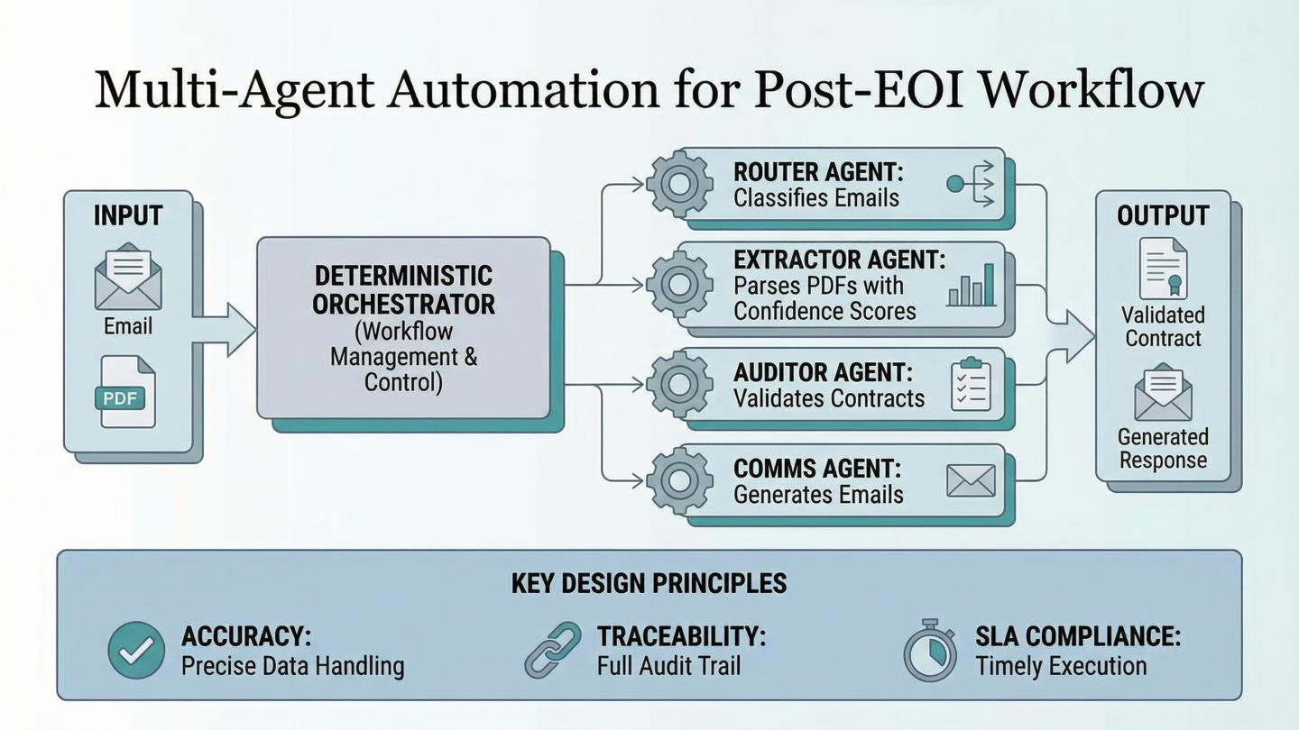

Slide 3
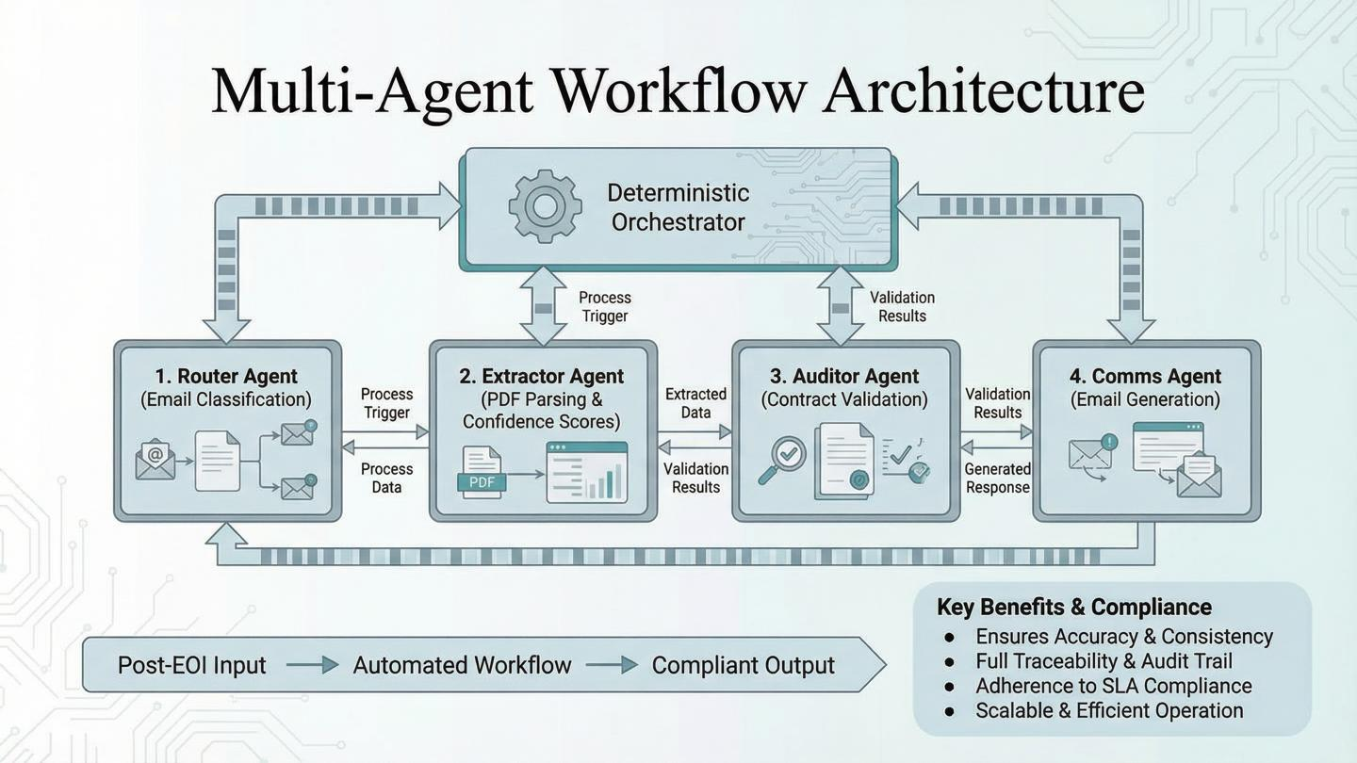

Slide 4
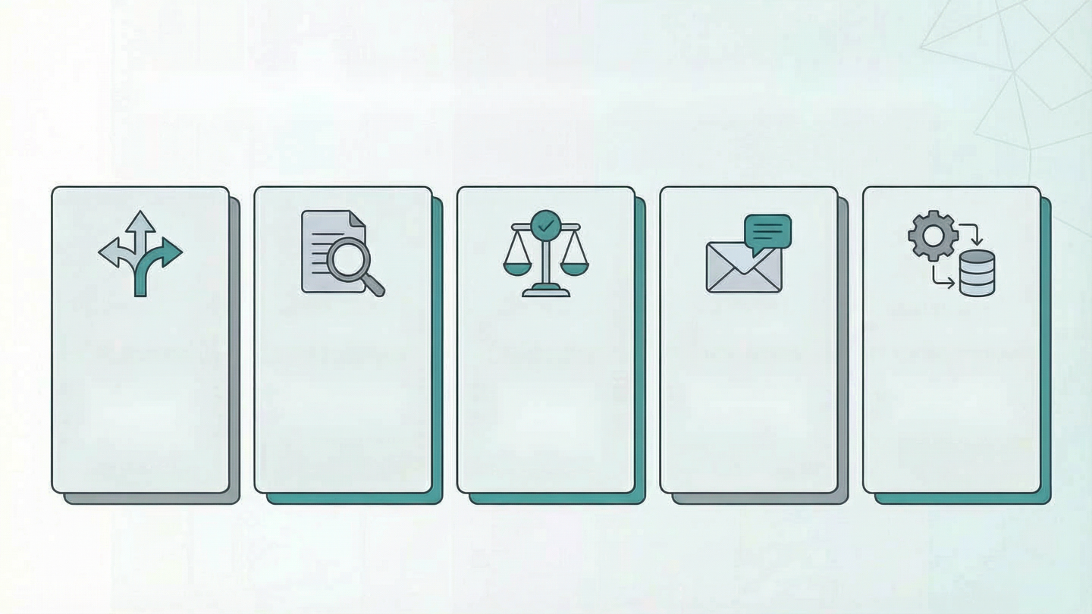
System Components & Technologies
Router
Extractor
Auditor
Comms
Orchestrator
Hybrid pattern matching + Claude Haiku 4.5 fallback
Claude Haiku 4.5 for PDF parsing, 30+ fields
Deterministic comparison + optional Qwen3-235B
Deterministic structure + LLM phrasing
Pure Python/SQLite, noLLM

Slide 5
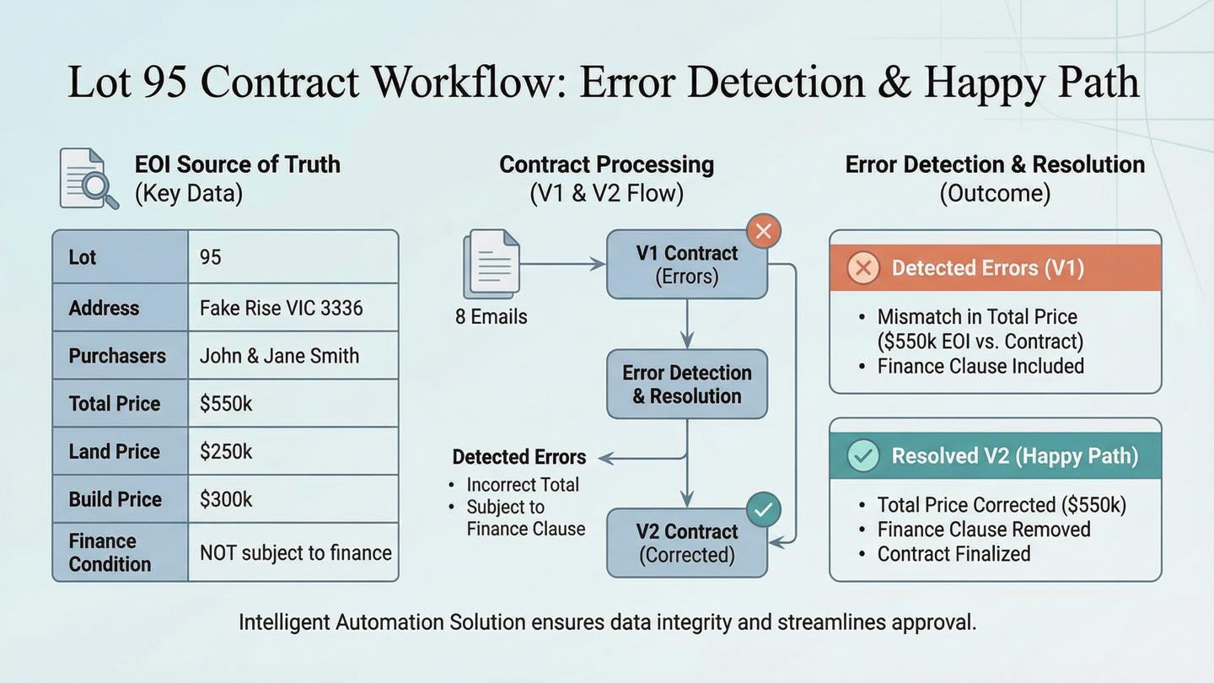

Slide 6
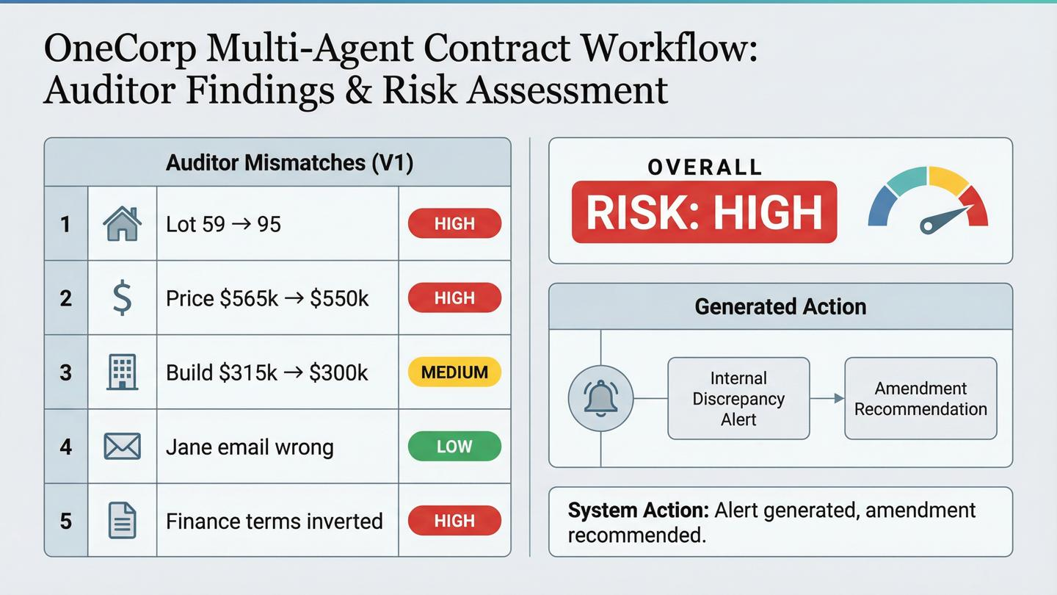

Slide 7
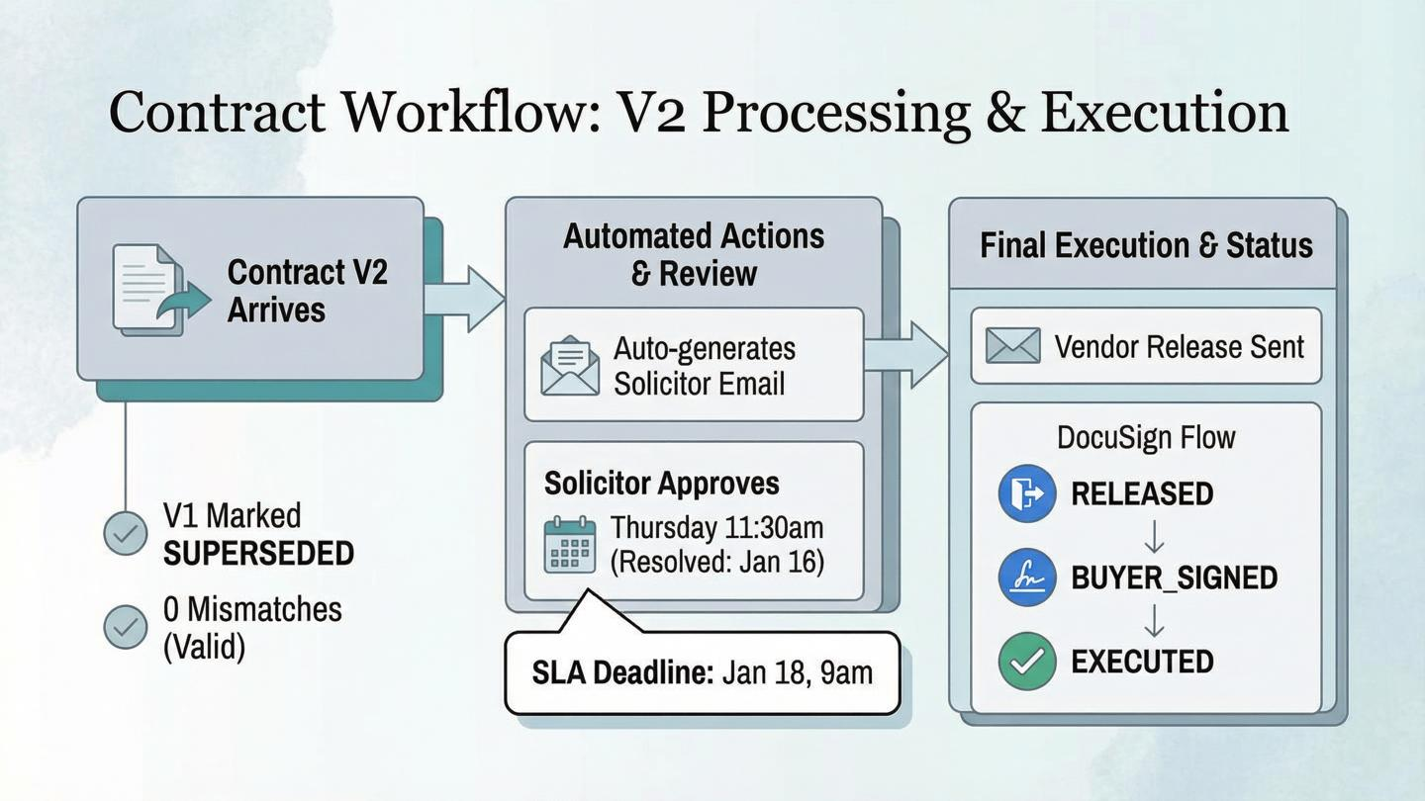

Slide 8
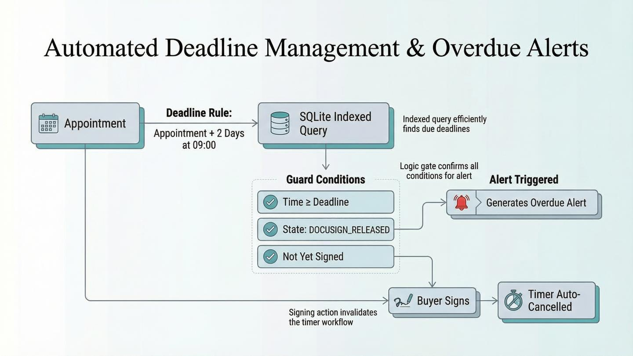

Slide 9
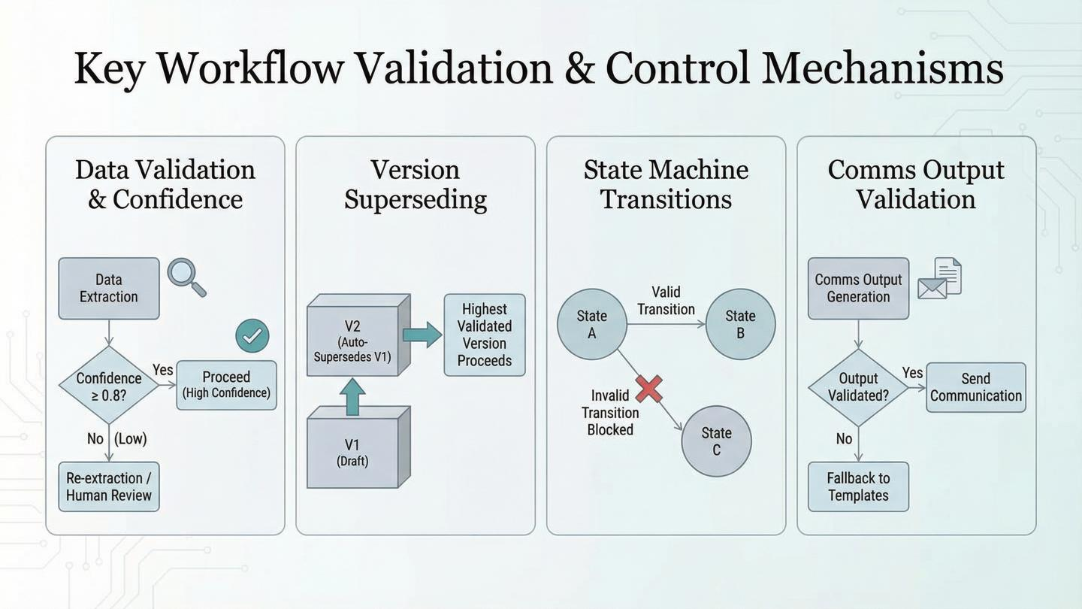

Slide 10
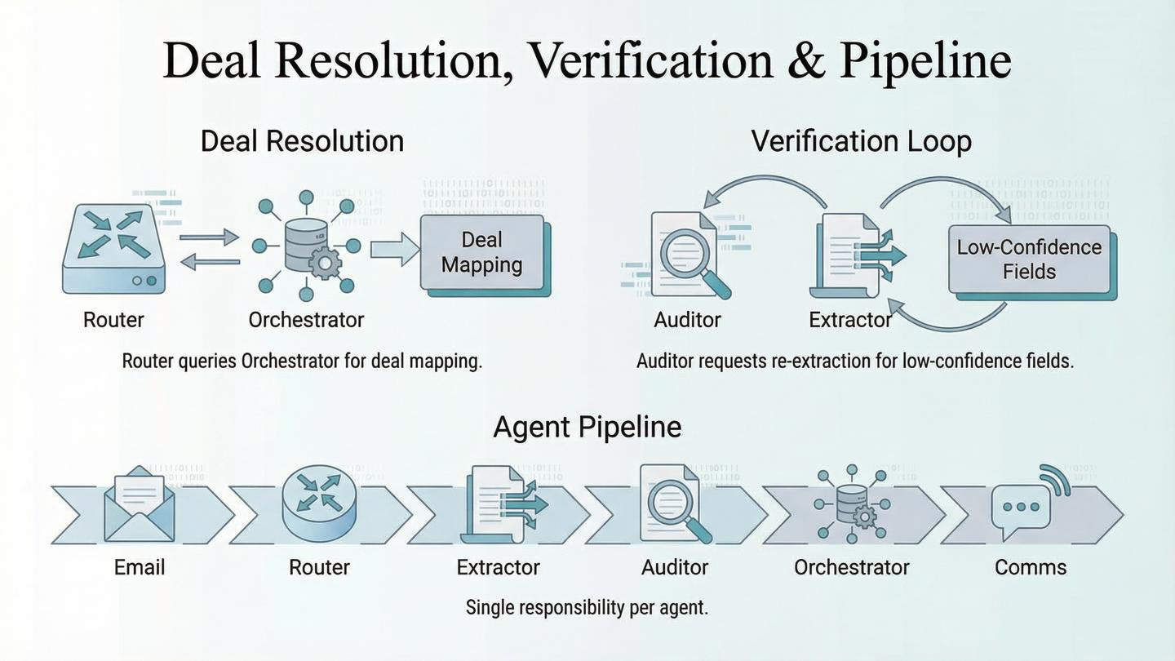

Slide 11
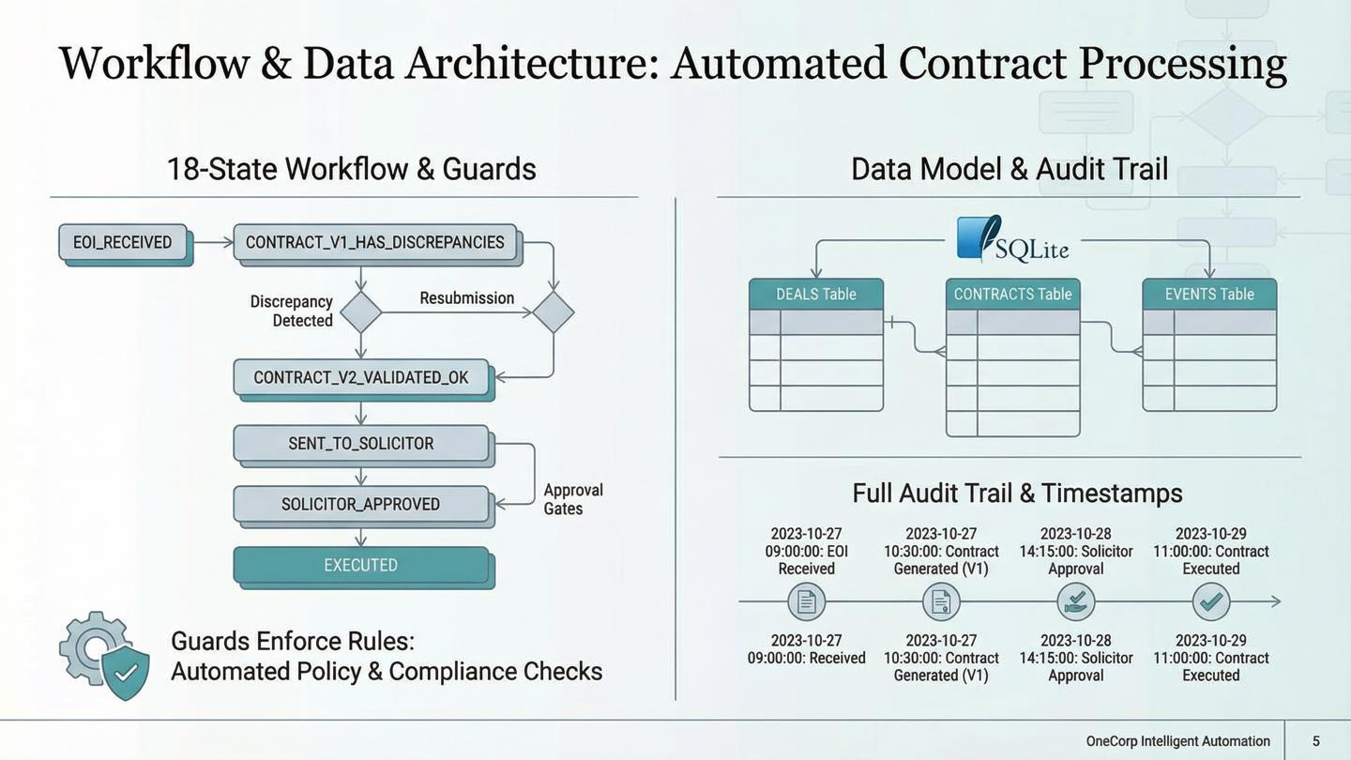

Slide 12
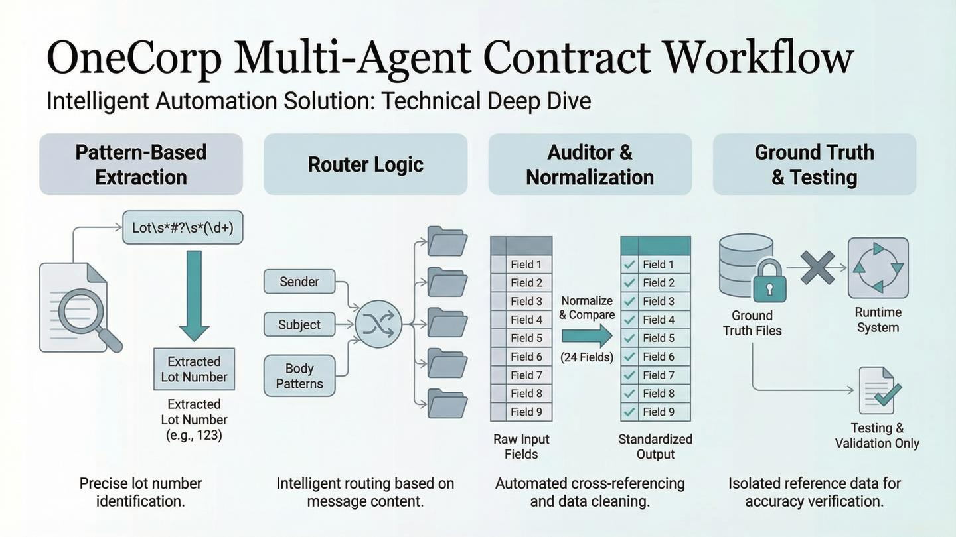

Slide 13
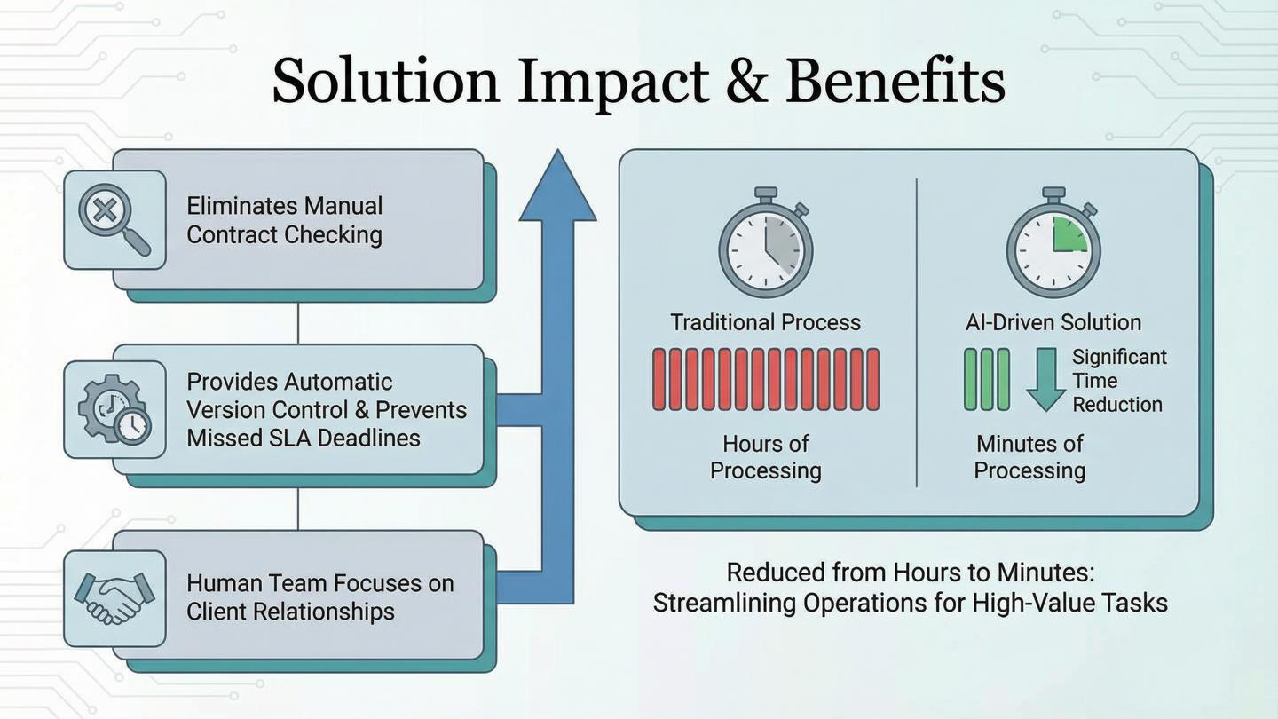

Slide 14
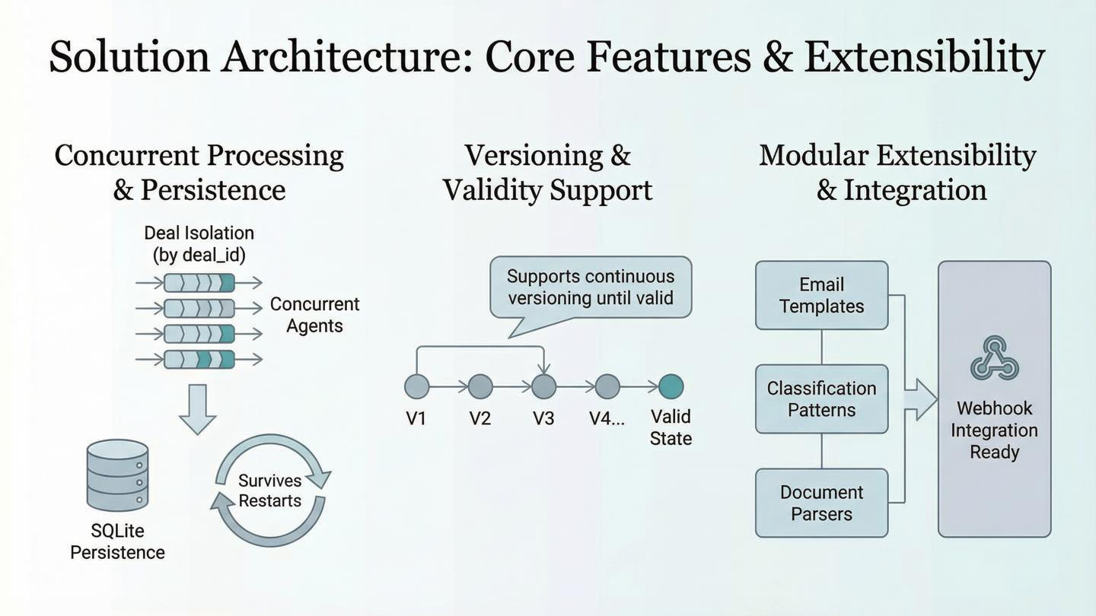

Slide 15
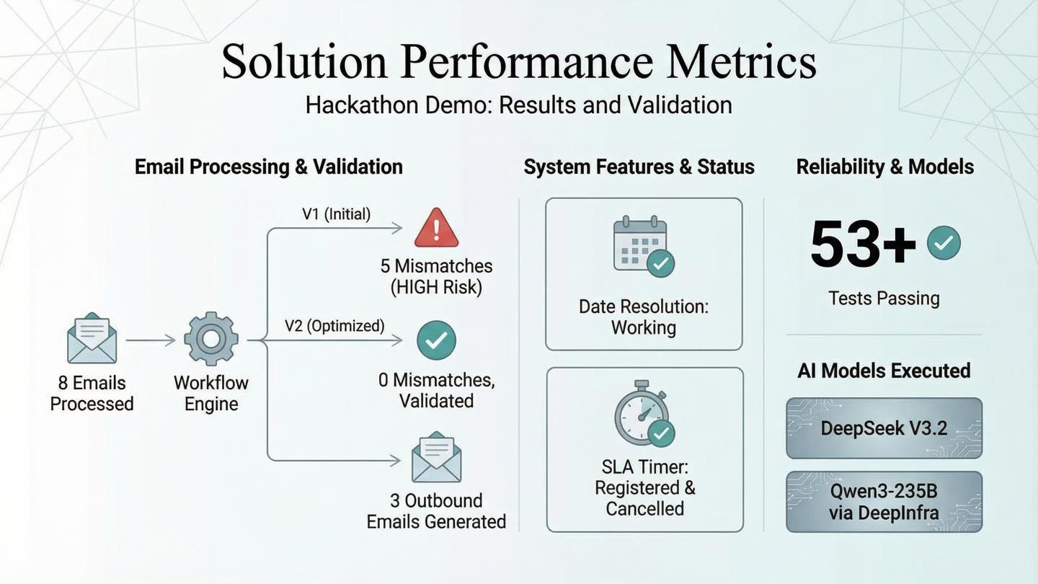
Claude Haiku 4.5

